Slide 1
IR 3.0
Kenneth Church
Feb 21, 2023

Slide 2
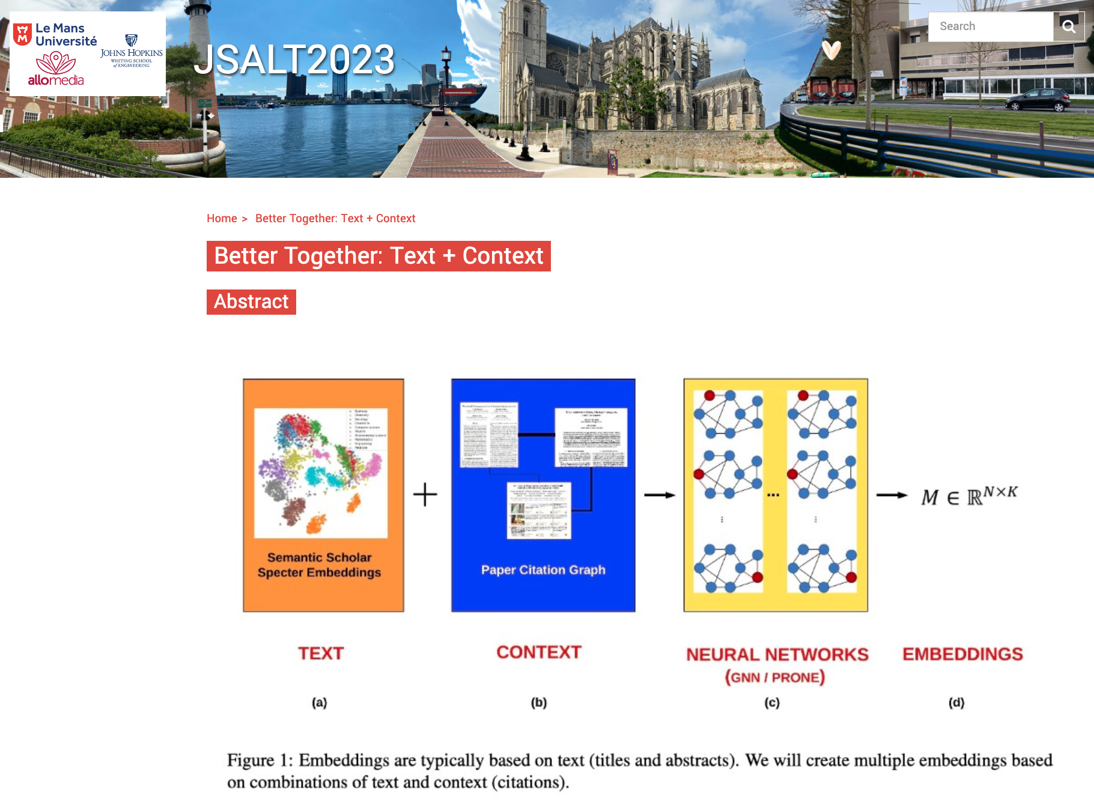
JSALT is a go! 2023 Jelinek Summer Workshop on Speech and Language Technology https://www.clsp.jhu.edu/2023-jelinek-summer-workshop/
Six weeks in France
Collaboration
Northeastern
Allen AI (Semantic Scholar)
UMass Amherst
Four Teams
Better together: Text + context
Ken Church (Northeastern)
Finite state methods with modern neural Architectures for speech applications and beyond
Mike Riley (Google)
Automatic design of conversational models from observation of human-to-human conversation
Interpretability for spoken interactions: how can we use embeddings to explain diarization decisions?

Slide 3
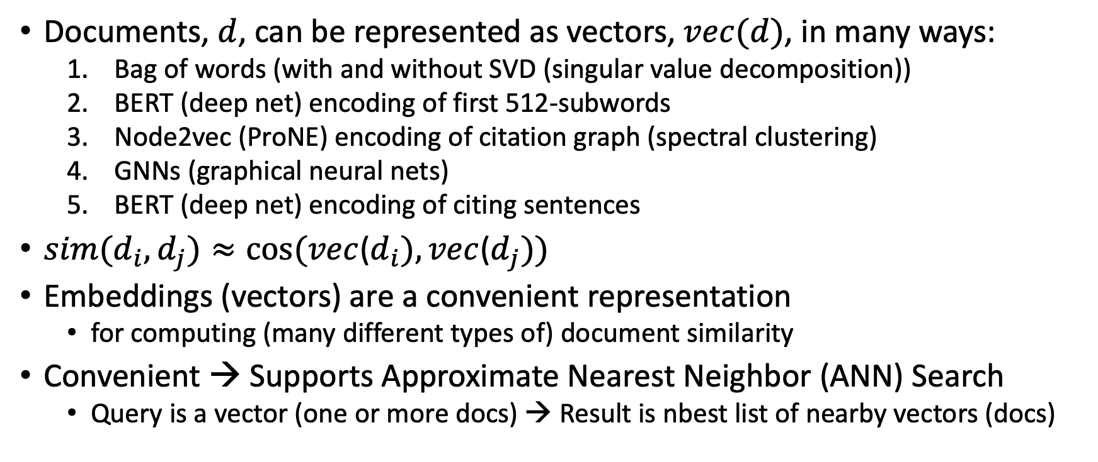
Embeddings (from multiple perspectives)
Documents, $d$, can be represented as vectors, $vec(d)$, in many ways:
Bag of words (with and without SVD (singular value decomposition))
BERT (deep net) encoding of first 512-subwords
Node2vec (ProNE) encoding of citation graph (spectral clustering)
GNNs (graphical neural nets)
BERT (deep net) encoding of citing sentences
$sim(d_{i},d_{j})≈cos⁡(vec$($d_{i}), vec$($d_{j}))$
Embeddings (vectors) are a convenient representation
for computing (many different types of) document similarity
Convenient → Supports Approximate Nearest Neighbor (ANN) Search
Query is a vector (one or more docs) → Result is nbest list of nearby vectors (docs)

Slide 4
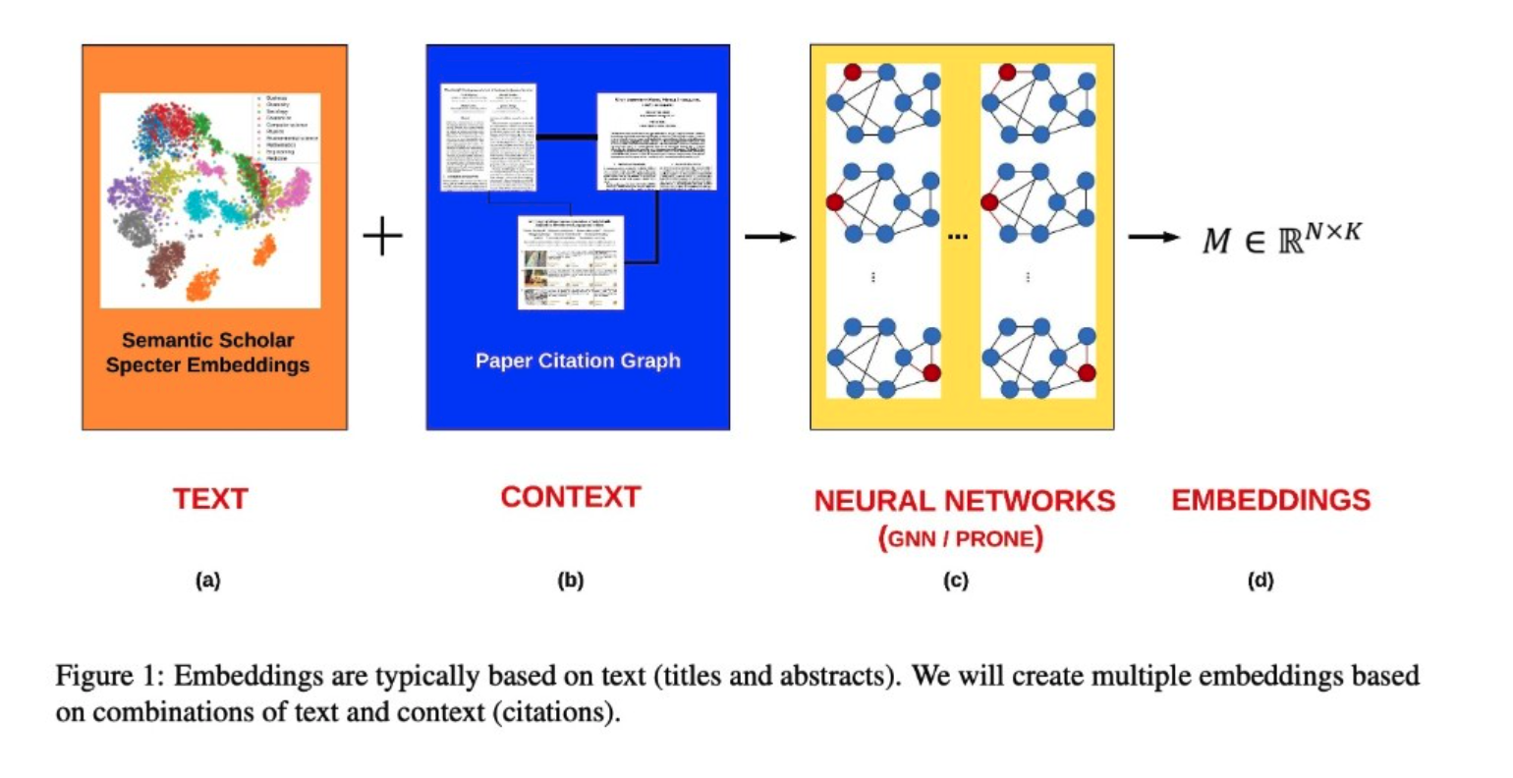

Slide 5
Bellcore’s Example: Bag of Words + SVD http://wordvec.colorado.edu/papers/Deerwester_1990.pdf
c1 Human machine interface for Lab ABC computer applications
c2 A survey of user opinion of computer system response time
c3 The EPS user interface management system
c4 System and human system engineering testing of EPS
c5 Relation of user-perceived response time to error measurement
m1 The generation of random, binary, unordered trees
m2 The intersection graph of paths in trees
m3 Graph minors IV: Widths of trees and well-quasi-ordering
m4 Graph minors: A survey

Slide 6
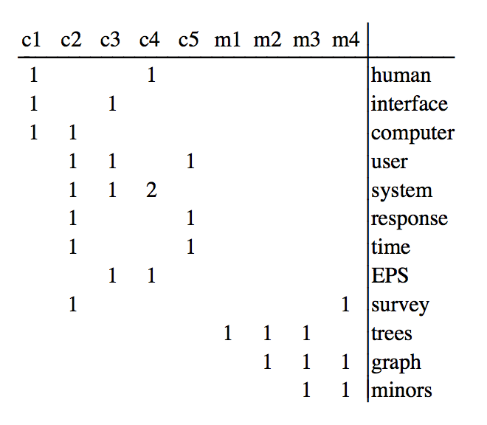
Term by Document Matrix

Slide 7
Dimension Reduction in R
"bellcore"<-
structure(.Data = c(1, 1, 1, 0, 0, 0, 0, 0, 0, 0, 0, 0, 0, 0, 1, 1, 1, 1,
1, 0, 1, 0, 0, 0, 0, 1, 0, 1, 1, 0, 0, 1, 0, 0, 0, 0, 1, 0, 0, 0, 2, 0,
0, 1, 0, 0, 0, 0, 0, 0, 0, 1, 0, 1, 1, 0, 0, 0, 0, 0, 0, 0, 0, 0, 0,
0, 0, 0, 0, 1, 0, 0, 0, 0, 0, 0, 0, 0, 0, 0, 0, 1, 1, 0, 0, 0, 0, 0,
0, 0, 0, 0, 0, 1, 1, 1, 0, 0, 0, 0, 0, 0, 0, 0, 1, 0, 1, 1),
.Dim = c(12, 9),
.Dimnames = list(c("human", "interface", "computer", "user",
"system", "response", "time", "EPS", "survey", "trees", "graph",
"minors"),
c("c1", "c2", "c3", "c4", "c5", "m1", "m2", "m3", "m4")))
b = svd(bellcore)
b2 = b$u[,1:2] %*% diag(b$d[1:2]) %*% t(b$v[,1:2])
dimnames(b2) = dimnames(bellcore)
par(mfrow=c(2,2))
plot(hclust(as.dist(-cor(bellcore))))
plot(hclust(as.dist(-cor(t(bellcore)))))
plot(hclust(as.dist(-cor(b2))))
plot(hclust(as.dist(-cor(t(b2)))))

Slide 8
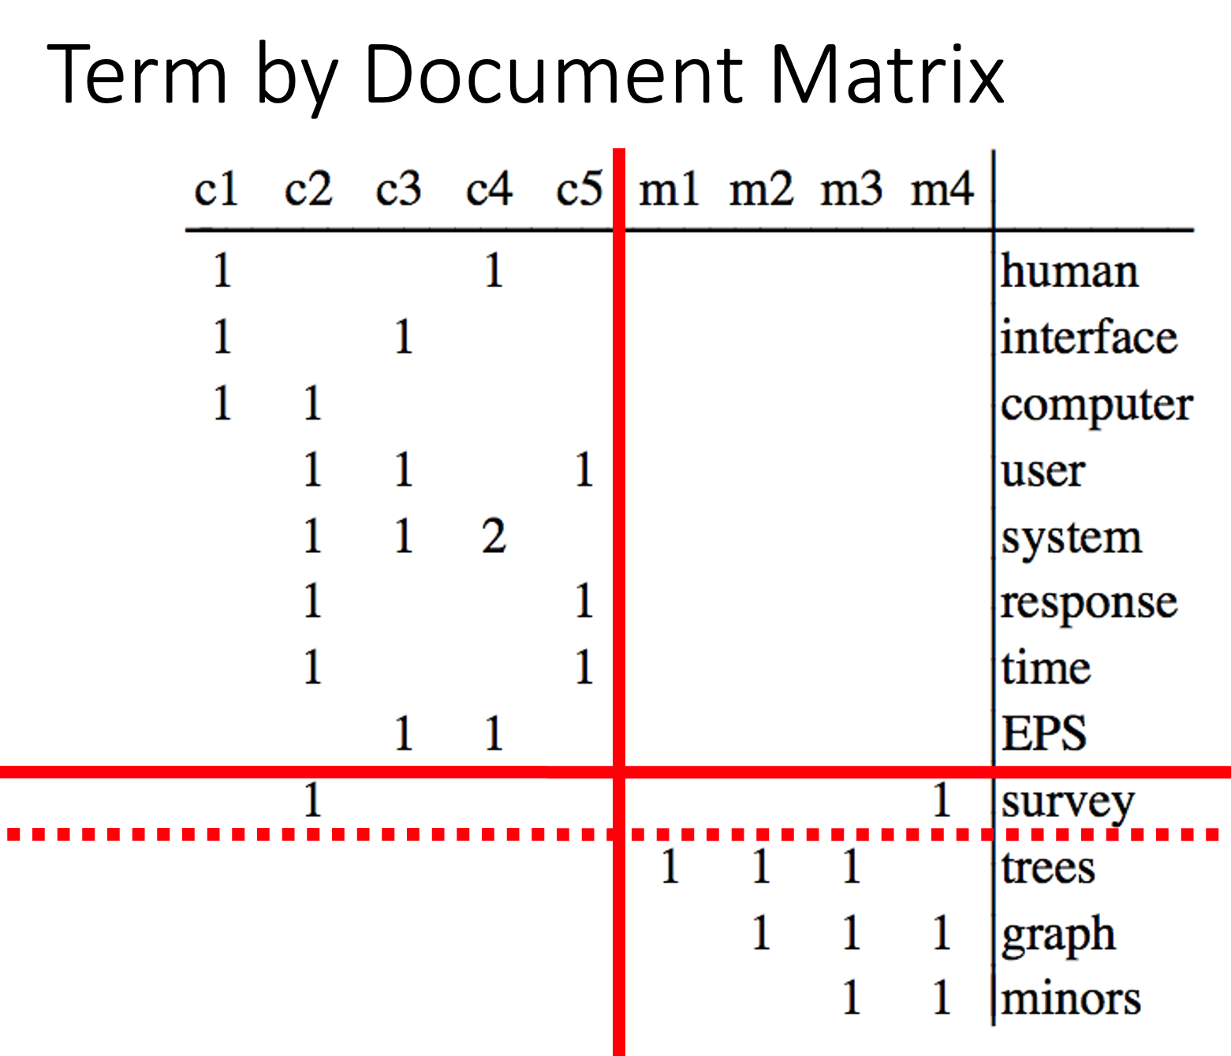
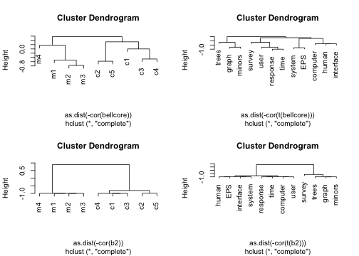
b = svd(bellcore)
b2 = b$u[,1:2] %*% diag(b$d[1:2]) %*% t(b$v[,1:2])
dimnames(b2) = dimnames(bellcore)
par(mfrow=c(2,2))
plot(hclust(as.dist(-cor(bellcore))))
plot(hclust(as.dist(-cor(t(bellcore)))))
plot(hclust(as.dist(-cor(b2))))
plot(hclust(as.dist(-cor(t(b2)))))

Slide 9
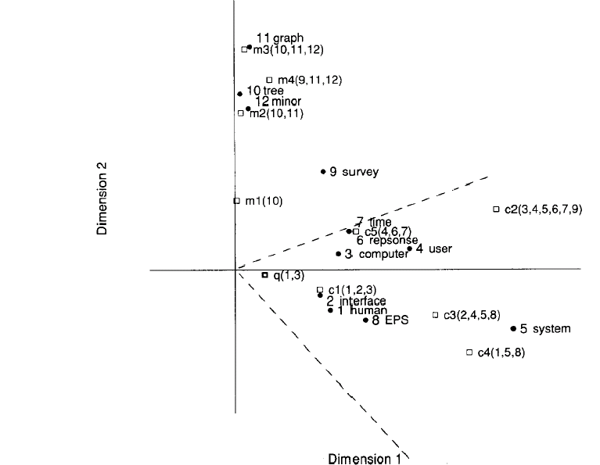
Latent concept vector space
• term
document
query
--- cosine > 0.9

Slide 10
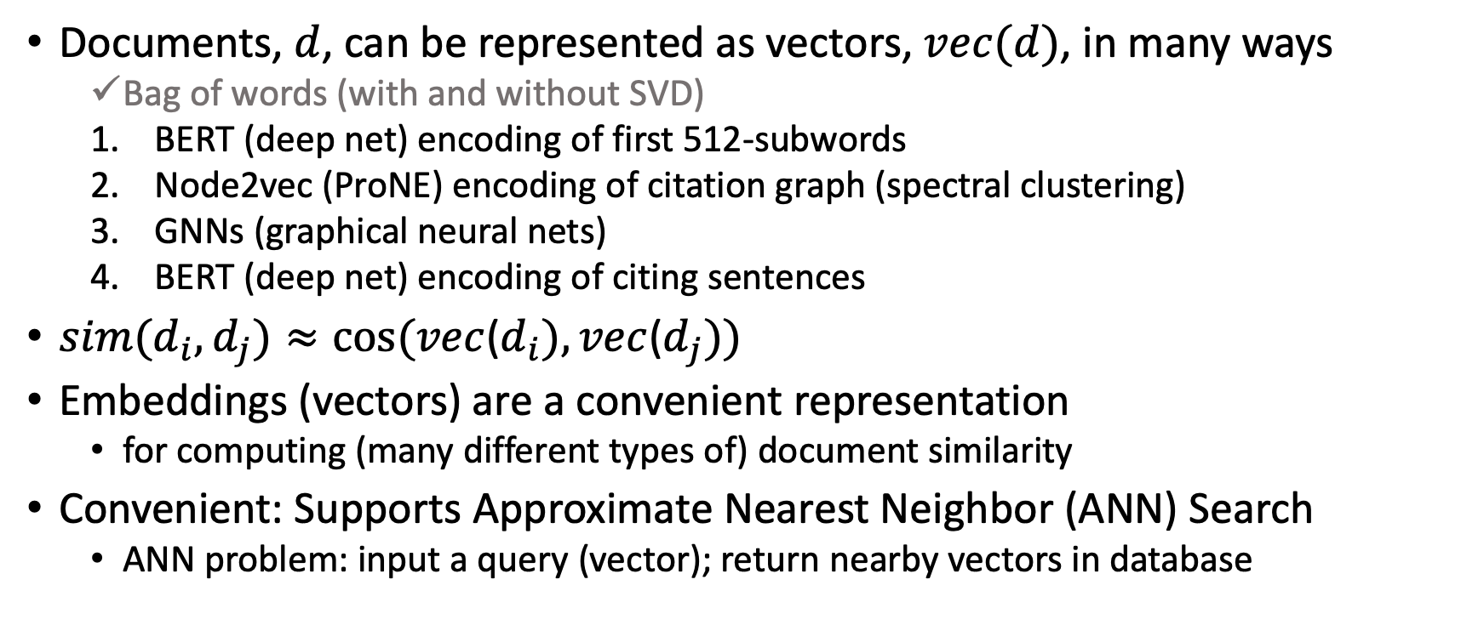
Embeddings (from multiple perspectives)
Documents, $d$, can be represented as vectors, $vec(d)$, in many ways
Bag of words (with and without SVD)
BERT (deep net) encoding of first 512-subwords
Node2vec (ProNE) encoding of citation graph (spectral clustering)
GNNs (graphical neural nets)
BERT (deep net) encoding of citing sentences
$sim(d_{i},d_{j})≈cos⁡(vec$($d_{i}), vec$($d_{j}))$
Embeddings (vectors) are a convenient representation
for computing (many different types of) document similarity
Convenient: Supports Approximate Nearest Neighbor (ANN) Search
ANN problem: input a query (vector); return nearby vectors in database

Slide 11
Agenda
Scale: Bellcore Toy Example → Semantic Scholar
200M documents; 2B citations
Map docs and/or citations → Embedding(s)
Practical Applications for ANN (Approximate Nearest Neighbors)
Recommender Systems
Expertise Finding
What should I read? Cite?
Who should review what?
Conferences would be better if reviewers were as qualified and as target audience
Why are we using grad students to review papers in areas they know nothing about????
WHO/ProMed Application
Theoretical Questions
In practice, bigger is better (for deep nets); Why?

Slide 12
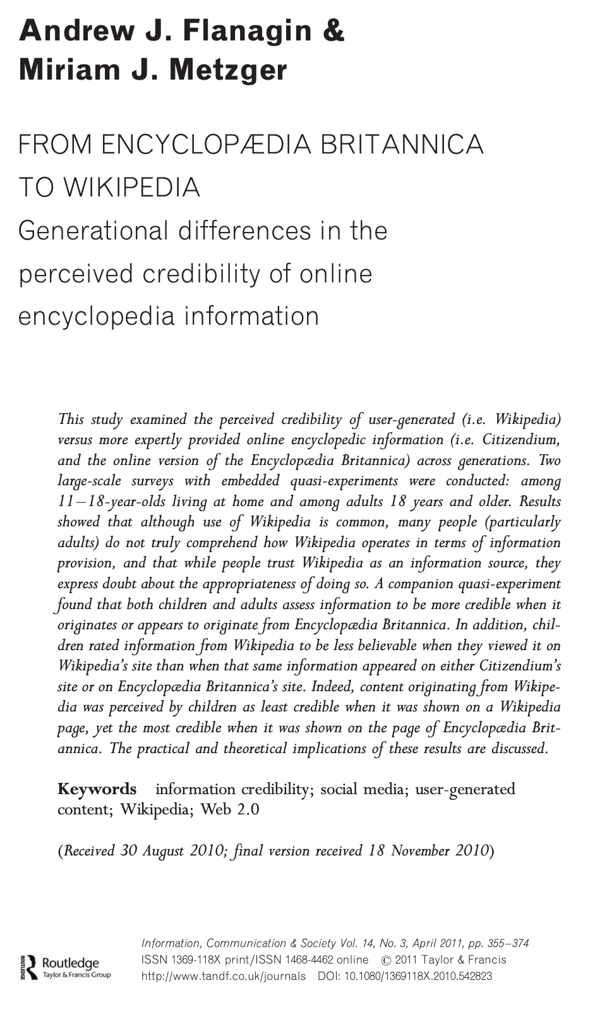
WHO/ProMed Application (Is Freeware >> Legit/Official/$$$ ?)
WHO:
Mandate to issue alerts
There are rumors that
WHO is subject to political pressure
ProMed:
Crowd-sourced alternative
Less subject to political pressure
Question(s):
Who scoops who? Credibility?
Data (from Sam Scarpino)
WHO: 3k URLs (102/year since 1996)
ProMed: 65k URLs (2384/year since 1996)
Method:
Map contents of URLs → Vectors
Find matches with ANN (approximate nearest neighbors)

Slide 13
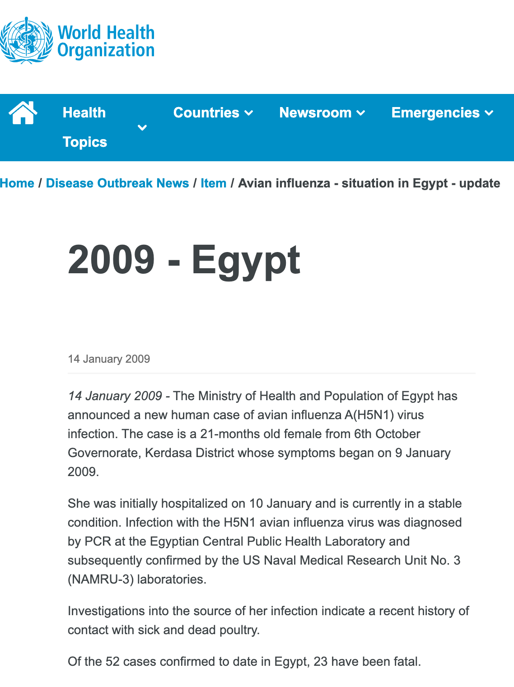

Challenge: Hall of Mirrors (too many matches) Jan 12: Reuters Jan 13: ProMED Jan 14: WHO
https://promedmail.org/promed-post/?id=20090113.0142
https://www.who.int/emergencies/disease-outbreak-news/item/2009_01_14a-en

Slide 14
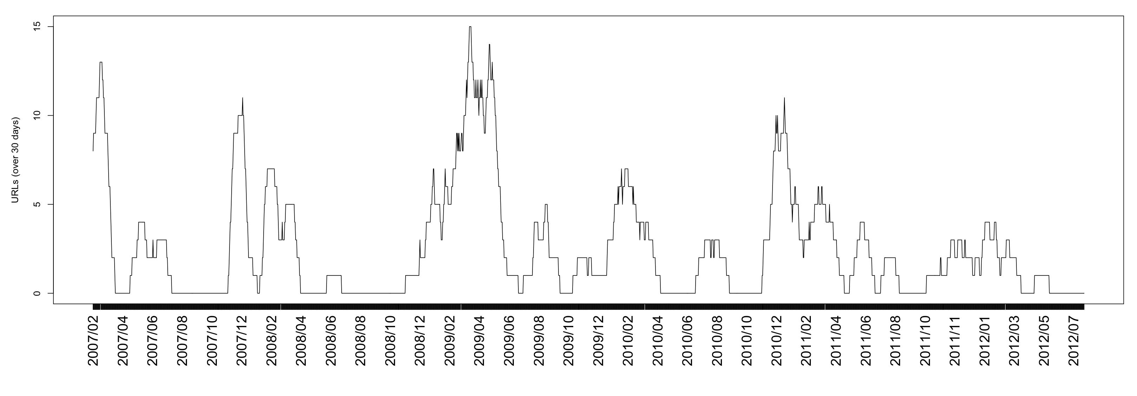
URLs about Egypt & Avian Flu
Date of WHO URL | Days since prev report
January 14, 2009 | 29
January 26, 2009 | 12
February 5, 2009 | 10
February 9, 2009 | 4
March 2, 2009 | 21
March 10, 2009 | 8
March 11, 2009 | 1
March 23, 2009 | 12
March 30, 2009 | 7
April 8, 2009 | 9
April 17, 2009 | 9
April 21, 2009 | 4
April 23, 2009 | 2
May 6, 2009 | 13
May 15, 2009 | 9
May 22, 2009 | 7
May 28, 2009 | 6
June 2, 2009 | 5
July 1, 2009 | 29
August 11, 2009 | 41
August 31, 2009 | 20
September 24, 2009 | 24
November 20, 2009 | 57
November 27, 2009 | 7
December 21, 2009 | 24
January 28, 2010 | 38
Jan 12: Reuters Jan 13: ProMED Jan 14: WHO
ProMED
19% of 2009 WHO reports mention “Egypt” & “Avian”

Slide 15
WHO / ProMED (Preliminary) Results
ProMED has more resolution
23x More reports (2384/year vs. 102/year)
More content per report
More citations to sources
If less is more
then WHO is brief and to the point
Alternative hypothesis:
More is more (but useful to summarize with timelines)
Challenge for Information Retrieval/Summarization: find the bigger picture
Failure to find (so far)
Not prepared to say that WHO is late because of politics

Slide 16
Agenda
Scale: Bellcore Toy Example → Semantic Scholar
200M documents; 2B citations
Map docs and/or citations → Embedding(s)
Practical Applications for ANN (Approximate Nearest Neighbors)
Recommender Systems
Expertise Finding
What should I read? Cite?
Who should review what?
Conferences would be better if reviewers were as qualified and as target audience
Why are we using grad students to review papers in areas they know nothing about????
WHO/ProMed Application
Theoretical Questions
In practice, bigger is better (for deep nets); Why?

Slide 17
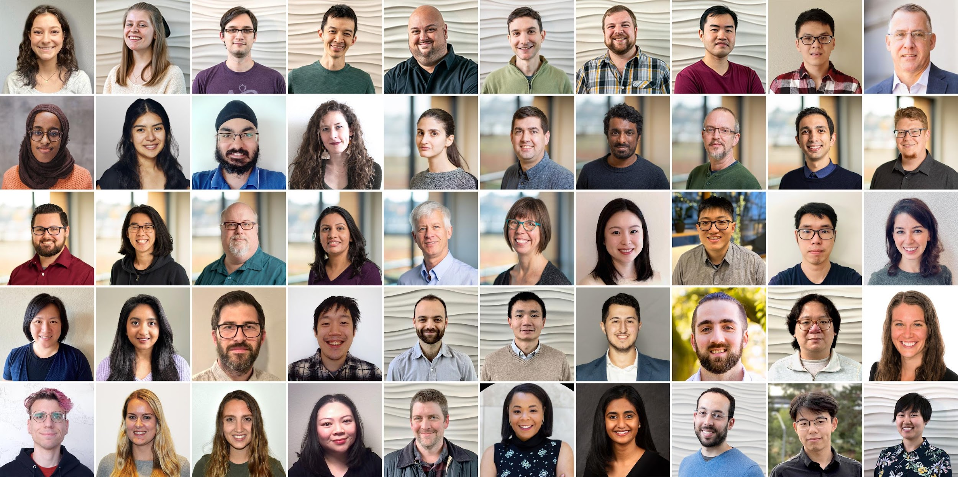
Semantic Scholar: Significant Effort (source: Dan Weld)
Semantic Scholar >> WHO + ProMED
WHO: 3k URLs (102/year since 1996)
ProMED: 65k URLs (2384/year since 1996)
SCALE | SCALE
 | Source | Papers (millions)
1 | CorpusId | 207.80
2 | MAG (Microsoft Academic Graph) | 182.18
3 | DOI | 113.54
4 | PubMed | 35.03
5 | DBLP | 6.06
6 | PubMedCentral | 4.86
7 | ArXiv | 2.15
8 | ACL | 0.08
50 person team; 7 year project
207M+ papers; 2B Citations
8M+ monthly active users
Full papers
Full papers
Full papers

Slide 18
Semantic Scholar API
Bulk access to titles, abstracts, BERT-like embeddings (specter)
Bulk access to citation graph G; node2vec(G) → embedding
Bulk access to citing sentences; BERT(citing sents) → embedding
Lots of great data; lots of scale; lots of embeddings
with different notions of similarity

Slide 19
Agenda
Scale: Bellcore Toy Example → Semantic Scholar
200M documents; 2B citations
Map docs and/or citations → Embedding(s)
Practical Applications for ANN (Approximate Nearest Neighbors)
Recommender Systems
Expertise Finding
What should I read? Cite?
Who should review what?
Conferences would be better if reviewers were as qualified and as target audience
Why are we using grad students to review papers in areas they know nothing about????
WHO/ProMed Application
Theoretical Questions
In practice, bigger is better (for deep nets); Why?

Slide 20
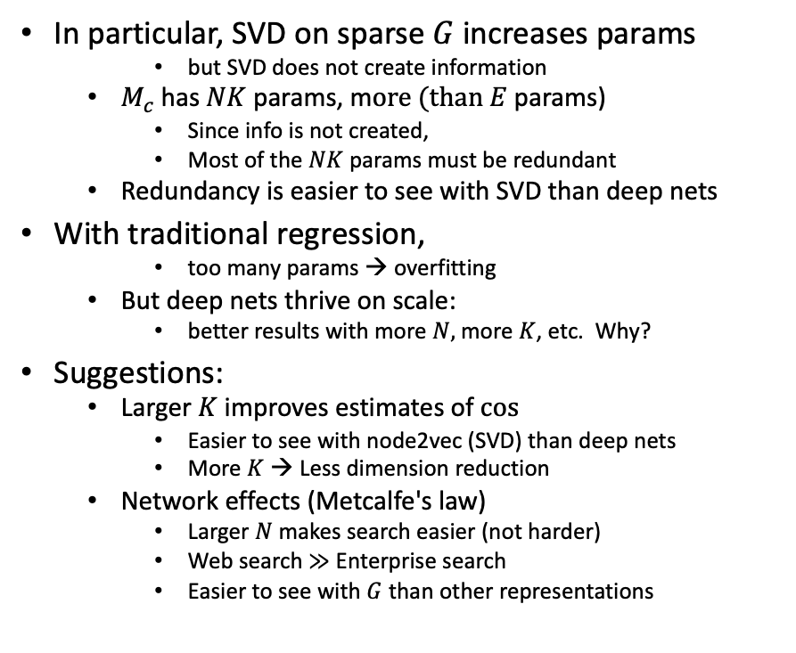
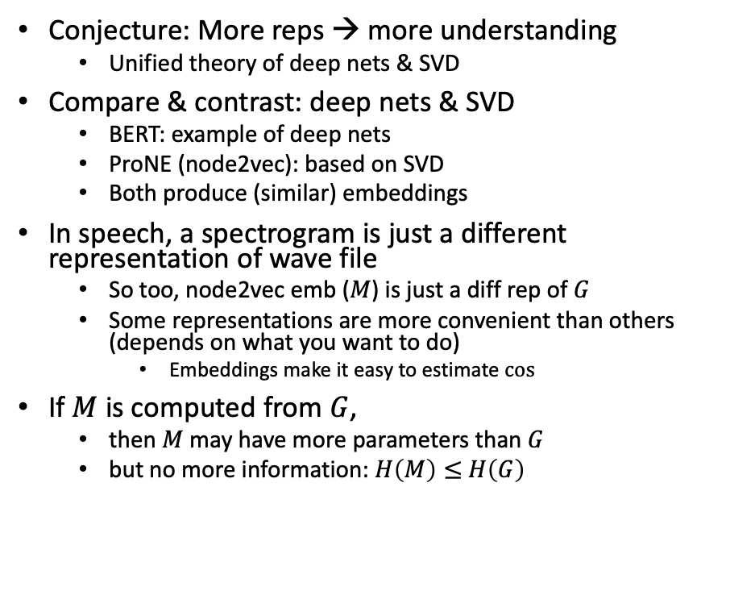
Bigger Stretch: Theoretical combinations of deep nets & SVD
Conjecture: More reps → more understanding
Unified theory of deep nets & SVD
Compare & contrast: deep nets & SVD
BERT: example of deep nets
ProNE (node2vec): based on SVD
Both produce (similar) embeddings
In speech, a spectrogram is just a different representation of wave file
So too, node2vec emb ($M$) is just a diff rep of $G$
Some representations are more convenient than others (depends on what you want to do)
Embeddings make it easy to estimate $cos⁡⁡$
If $M$ is computed from $G$,
then $M$ may have more parameters than $G$
but no more information: $H\left(M\right)≤$ $H\left(G\right)$
In particular, SVD on sparse $G$increases params
but SVD does not create information
$M_{c}$has $NK$ params, m$ore (than E$params)
Since info is not created,
Most of the $NK$ params must be redundant
Redundancy is easier to see with SVD than deep nets
With traditional regression,
too many params → overfitting
But deep nets thrive on scale:
better results with more $N,$ more $K$, etc. Why?
Suggestions:
Larger $K$ improves estimates of $cos⁡$
Easier to see with node2vec (SVD) than deep nets
More $K$ → Less dimension reduction
Network effects (Metcalfe's law)
Larger $N$ makes search easier (not harder)
Web search $≫$ Enterprise search
Easier to see with $G$ than other representations

Slide 21
Agenda / Conclusions
Scale: Bellcore Toy Example → Semantic Scholar
200M documents; 2B citations
Map docs and/or citations → Embedding(s)
Practical Applications for ANN (Approximate Nearest Neighbors)
Recommender Systems
Expertise Finding
What should I read? Cite?
Who should review what?
Conferences would be better if reviewers were as qualified and as target audience
Why are we using grad students to review papers in areas they know nothing about????
WHO/ProMed Application
Theoretical Questions
In practice, bigger is better (for deep nets); Why?

